Slide 1
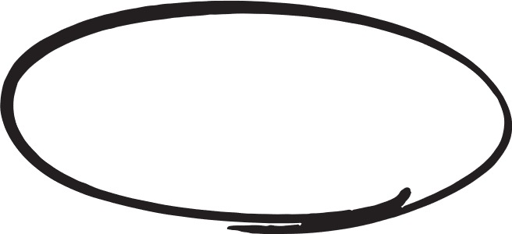
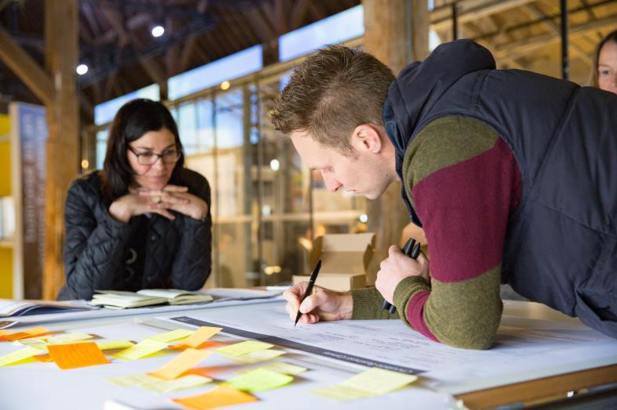
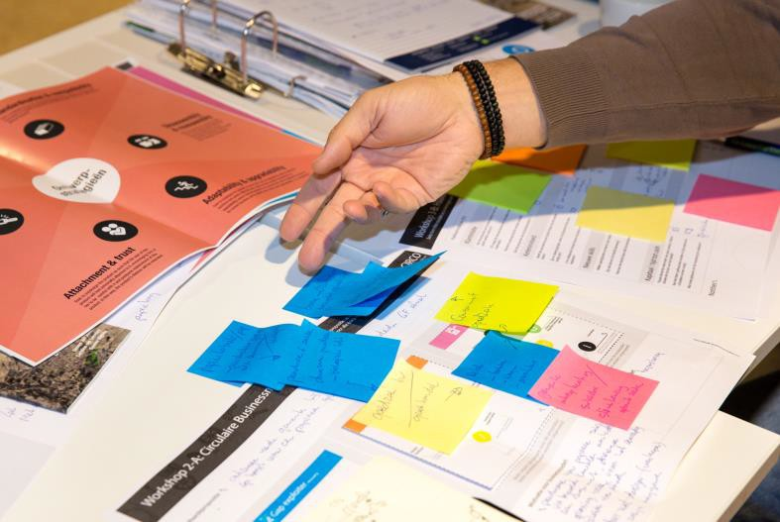
CIRCO accelerates the development towards a circular economy, with design as the driving force. During a Track, participants are extensively acquainted with the possibilities of circular design and entrepreneurship for their business. Participants explore opportunities and take concrete first steps in the development of new products, services and business models.
Joined by more than 1.000 companies!
What does the CIRCO method entail?
Deliverables
Companies participating in a CIRCO program will go through the carefully designed and tested, process steps: initiate, ideate and implement resulting in the following deliverables.
1. Knowledge of circular design strategies and business models
Participants become acquainted with the possibilities of circular design and entrepreneurship, and get to work with circular business models and design strategies.
2. A proposition for a circular business model and a redesign of your product or service
The CIRCO Track helps you increase your competitiveness and create new values for your organization and customers.
3. A roadmap for implementation of their proposition
You will develop a plan for your organization or company that can be realized in the short term and gain insight into possible system changes in the long term.
4. Become part of the CIRCO community
You will become part of a broad network of circular frontrunners.

Slide 2
More than 2.000 companies already joined!
Do you want to learn more about CIRCO International, Hubs and programmes?
Go to circonl.nl/international
Circular Business Design Track
– ARMENIA
3 Day workshop
What will you gain?
Circular Economy is a system in which high-quality services are provided and where products last longer, are cleverly reused and recycled. This requires new designs and new business models, new chains and new collaborations. CIRCO’s Business Design Track helps you discover new opportunities and set up your own circular business case, and brings chain partners together.
During the CIRCO track you will discover circular business opportunities and you will develop a concrete plan that can be realized in the short term for your company.
Working together within chain partners makes your ideas smarter and more feasible.
You will have access to up-to-date knowledge and concrete useful tools.
In addition, you gain insight into possible system changes in the long term.
Who can participate?
The CIRCO Track is for professionals like business developers, designers, marketeers, operations, innovation and commercial managers from various organizations. It is a highly interactive training working around a specific theme .

Slide 3
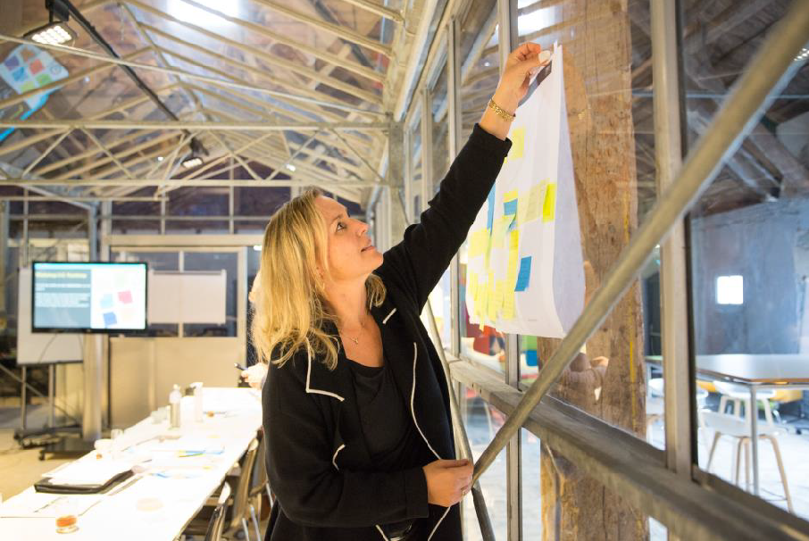
2/3 of CIRCO
alumni are currently in
circular business
Practical information
Investment
Participants
Programme
This workshop is being offered free-of-charge within the framework of Impact Hub Yerevan’s “CirculUP!” program.
Per company 2 people participate: someone with a technical background (designer, engineer) and someone with a commercial background (marketing, business administration, purchasing).
The programme consists of one online info-session and three offline half-day workshops. In between these contact moments, you will work on your individual case.
Day 1 – INITIATE WORKSHOP
6 hours
During this first day you will dive into the ideas of the circular economy. We analyze the current linear value chain.
Day 2 – IDEATE WORKSHOP
6 hours
In the second session we will focus on circular business models and design strategies.
Day 3 – IMPLEMENTATION WORKSHOP
6 hours
We look at the technical and commercial feasibility of the results of the previous workshop, their consequences for business operations and the circular impact. You also learn to deal with barriers.

